Slide 1
Web Programming
Project-1

Slide 2
Multi Mailbox System
Saurabh Maydeo & Chaitanya Sai Linga

Slide 3

Problem Statement
Checking emails regularly during the day in different tabs can be a time consuming way to keep inbox at manageable levels. So, the effective approach is to easily access multiple Inbox concurrently.

Slide 4
Solution
In This Project we developed a simple web app to manage multiple Email Inbox view in a very creative and user Friendly manner.
eg: Gmail and outlook are taken for use case

Slide 5

Landing Page : Homepage

Slide 6

Landing Page : Homepage View-2

Slide 7
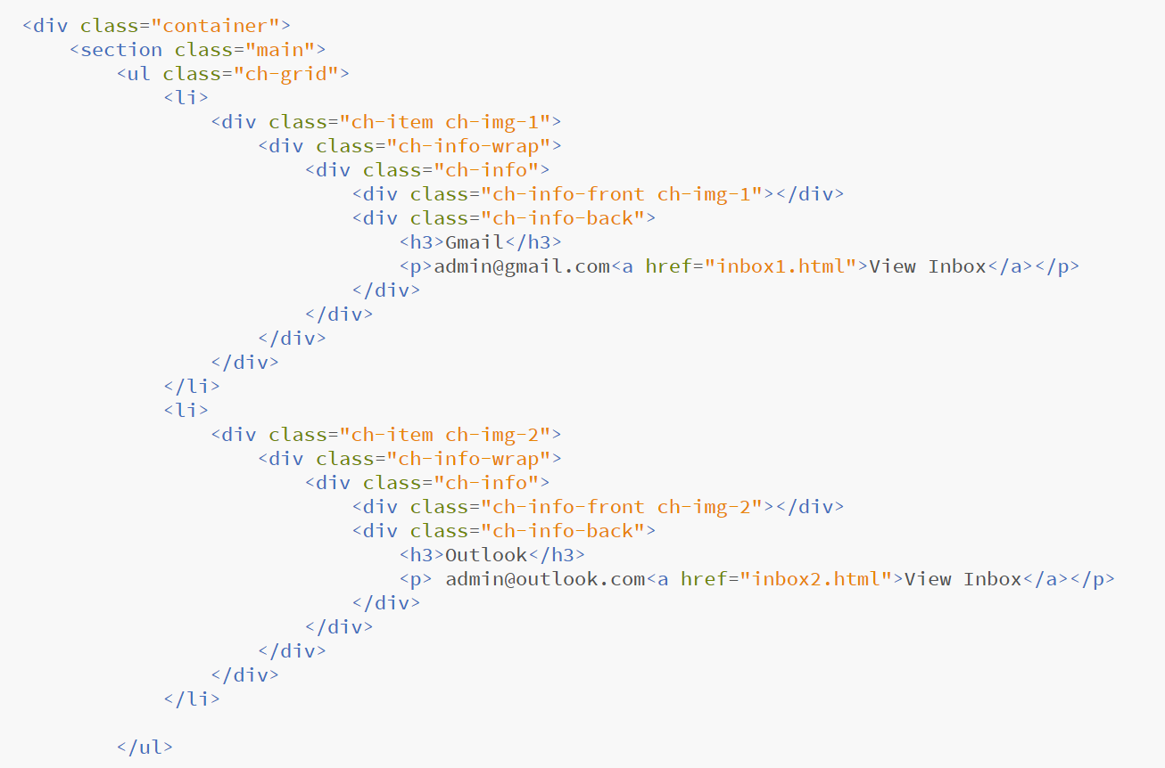
HTML Code

Slide 8
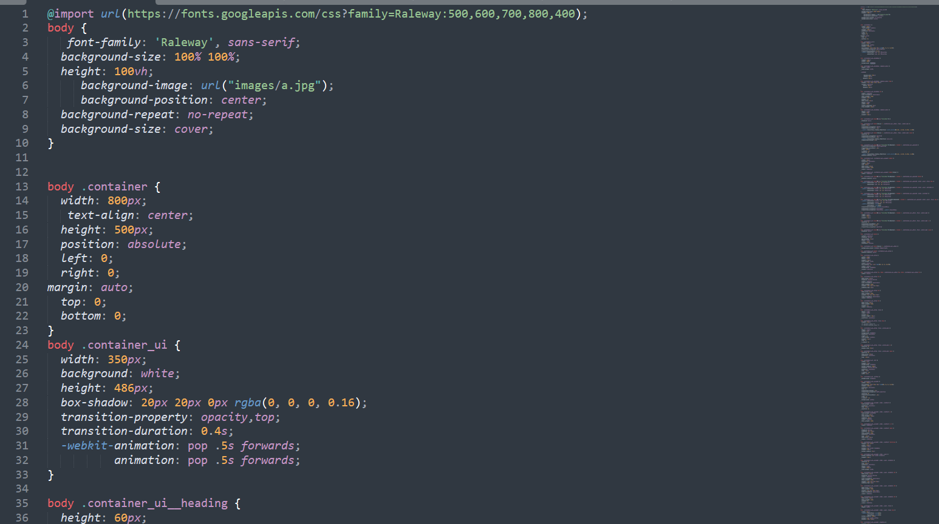
CSS Code

Slide 9
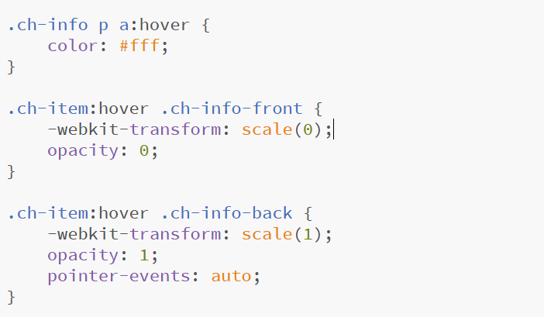
Hover Code

Slide 10
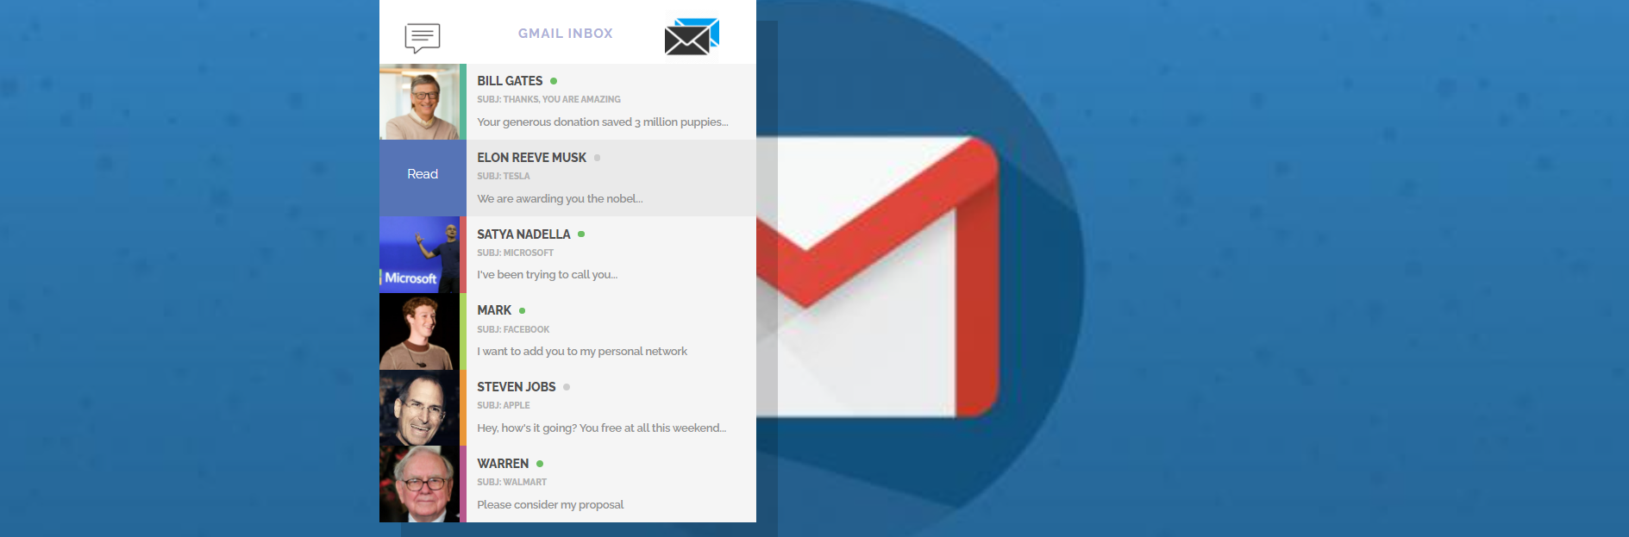
Gmail Inbox Screen

Slide 11
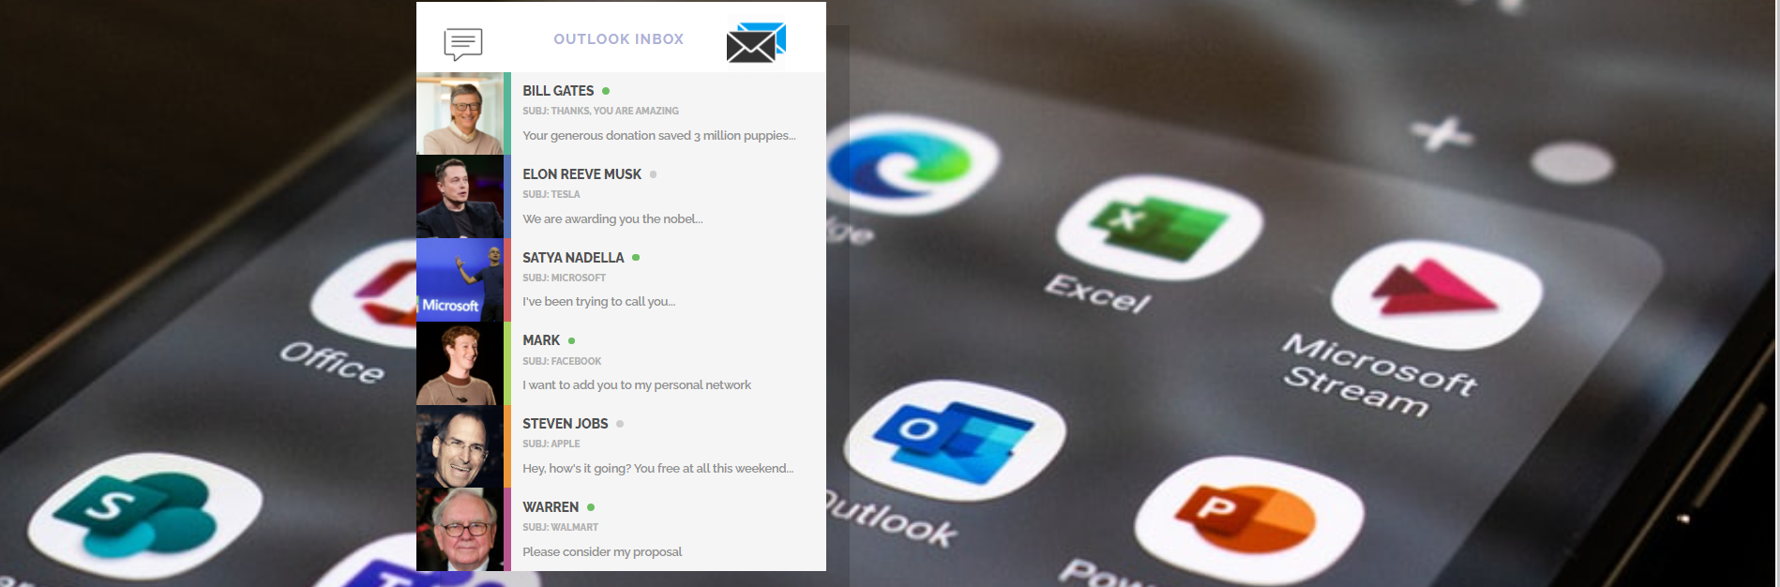
Outlook Inbox Screen

Slide 12


